Slide 1
AS and Phillips curve
Lecture 4
Mentor: Pham Xuan Truong
(truongpx@ftu.edu.vn)

Slide 2
Content
I Four models of aggregate supply
II Phillips curve

Slide 3
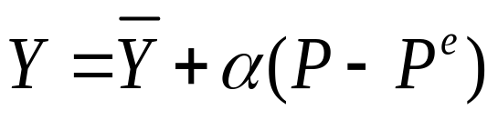

Model Background
Most economists analyze short-run fluctuations in aggregate income and the price level using the AD/AS model.
Earlier we introduced long-run AS as a vertical line which implied perfect flexibility for prices.
Our short-run AS curve was perfectly horizontal which implied perfect rigidity for prices.
Now to better reflect the real world in which some prices are sticky and others are not. we will propose theories for a positively sloped AS curve. This implies a tradeoff between inflation and unemployment.
All three models adhere to the following functional form of aggregate supply.
where α>0, Y is output,
is the natural rate of output, P is the
price level, and P^{e} is the expected price level.

Slide 4
Model Background
This equation states that output deviates from its natural rate when the price level deviates from the expected price level. α indicates how much output responds to unexpected changes in P and 1/α is the slope of the AS curve.
Although each of the three theories adheres to the given functional form, each highlights a different reason why unexpected movements in the price level are associated with fluctuations in aggregate output.

Slide 5
I Four models of aggregate supply
(1) The sticky wage model
(2) The worker - misperception model
(3) The imperfect information model
(4) The sticky price model
(1) (2) Focus on labor market; (3) (4) Focus on goods market
(1) (2) (3) From P change to Y change; (4) From Y change to P change
(1) (4) price and wage are sticky; (2) (3)price and wage are flexible

Slide 6

(1) The Sticky Wage Model
Many economists believe
that nominal wages are sticky
in the short run.
When the nominal wage is stuck, a rise in P from P₀ to P₁ lowers the real wage, making labour cheaper.
W/P
The lower real wage induces firms to hire more labour.
W/P₀
W/P₁
D_{L}
The positive relationship between P and Y means AS slopes upward.
L₀
L₁
L
P
The additional labour hired produces more output.
Y
Y₁
Y=F(L)
P₁
Y₀
P₀
Y₀
Y₁
Y
L₀
L₁
L

Slide 7
(1) The Sticky Wage Model
The downfall of the sticky wage model is that it predicts a countercyclical relationship between the real wage and output. Actual data suggests a procyclical relationship, meaning that nominal wage is not rigid as the model predicts

Slide 8
(2) The worker - misperception model
Unlike the sticky-wage model, this model developed by Milton Friedman (1968) assumes that markets clear—that is, all wages and prices are free to adjust to balance supply and demand.
Additionally, the model presumes workers cannot perceive correctly about the price and firms have no accurate information about price
→ labor supply is based on actual real wage, labor demand is based on expected real wage

Slide 9
(2) The worker - misperception model
+ If P > Pe → workers believe that nominal wage will be adjusted quickly so that actual real wage can be higher than expected real wage → labor supply increases
+ If P < Pe → workers believe that nominal wage will be adjusted quickly so that actual real wage can be lower than expected real wage → labor supply decreases

Slide 10
(3) The imperfect information model
Like worker – misperception model, all wages and prices are free to adjust to balance supply and demand. In the model developed by R.Lucas (1970), the short-run and long-run aggregate supply curves differ because of temporary misperceptions about prices.
The imperfect-information model assumes that each supplier in the economy produces a single good and consumes many goods. Because the number of goods is so large, suppliers cannot observe all prices at all times. They monitor the prices of their own goods but not the prices of all goods they consume. Due to imperfect information, they sometimes confuse changes in the overall price level with changes in relative prices. This confusion influences decisions about how much to supply, and it leads to a positive relationship between the price level and output in the short run.

Slide 11
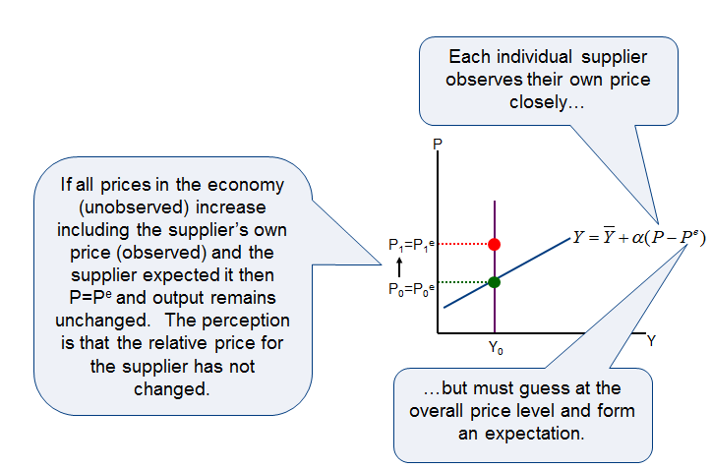
(3) The imperfect information model

Slide 12
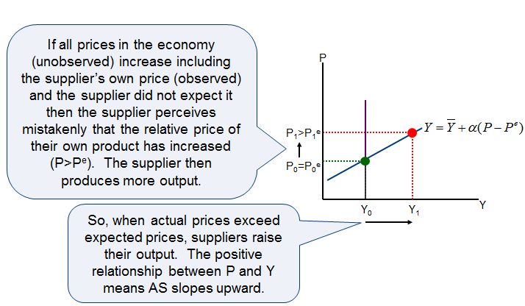
(3) The imperfect information model

Slide 13
(4) The sticky price model
This model explains an upward sloping AS curve by assuming that some prices are sticky because
  firms have long term contracts with input suppliers
  firms hold prices steady in order not to annoy regular customers with frequent price changes, and
  for firms who have printed and distributed a catalog or price list it is too costly to alter prices.

Slide 14
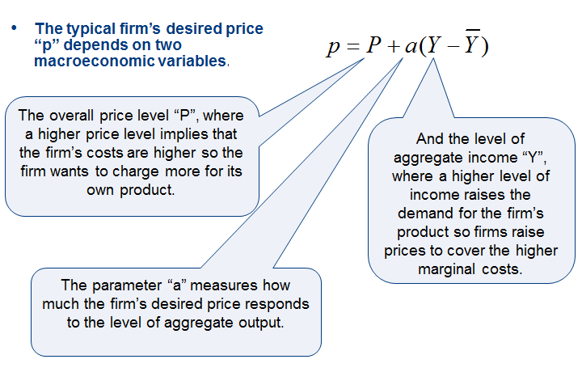
(4) The sticky price model

Slide 15
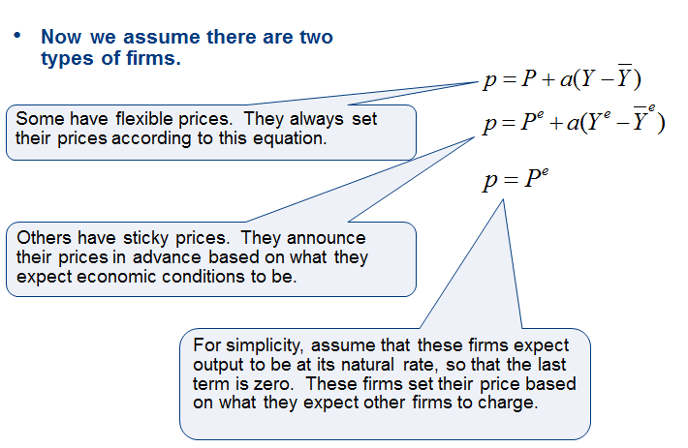
(4) The sticky price model

Slide 16
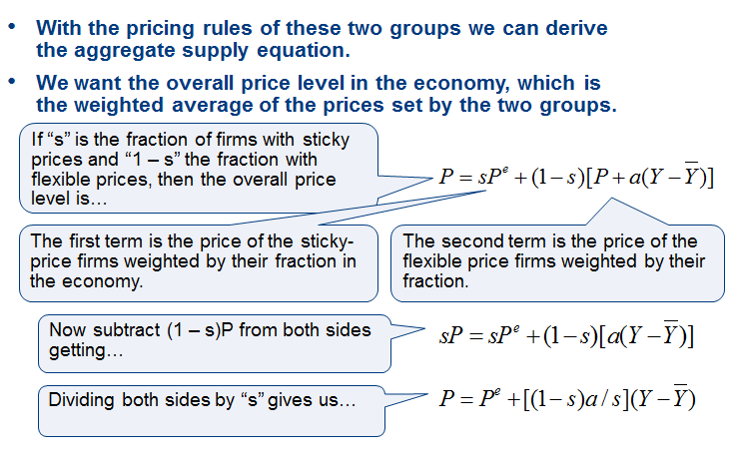
(4) The sticky price model

Slide 17
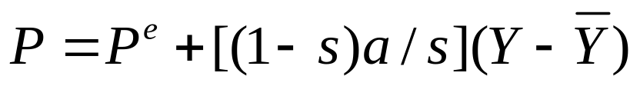
(4) The sticky price model
So when firms expect a high price level, they expect high costs. Those firms that fix prices in advance set their prices high. These high prices cause the other firms to set high prices also. Hence, a high expected price level P^{e} leads to a high actual price level P.
When output is high, the demand for goods is high. Those firms with flexible prices set their prices high, which leads to a high price level. The effect of output on the price level depends on the proportion of firms with flexible prices.
→ So, the overall price level depends on the expected price level and on the level of output.

Slide 18
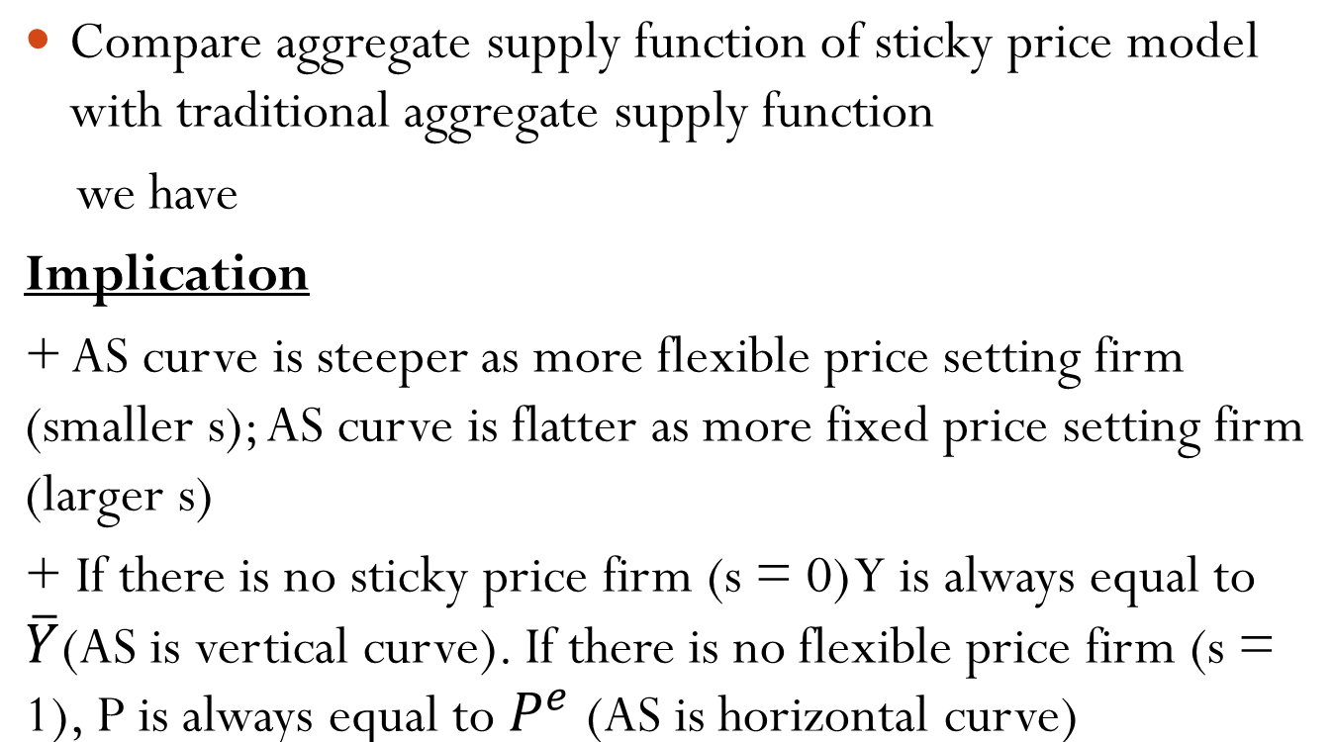


(4) The sticky price model

Slide 19
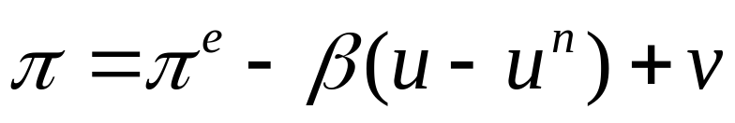
II Phillips curve
What is Phillips curve?
Phillips curve implies the relationship between unemployment rate and inflation rate. The Phillips curve shows the trade-off facing policy makers in terms of unemployment and inflation.
The Phillips curve in its modern form states that the inflation rate depends on three forces:
1) Expected inflation
2) The deviation of unemployment from the natural rate, called
cyclical unemployment
3) Supply shocks

Slide 20
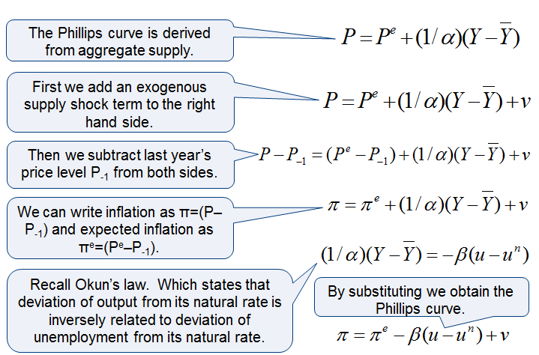
II Phillips curve
Building Phillips curve
→Phillips curve and the short run aggregate supply curve essentially represent the same economic ideas.

Slide 21
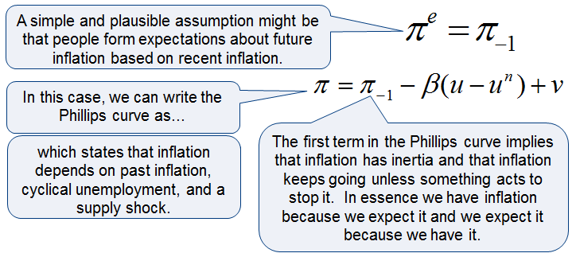
II Phillips curve
Adaptive expectation and inflation inertia

Slide 22
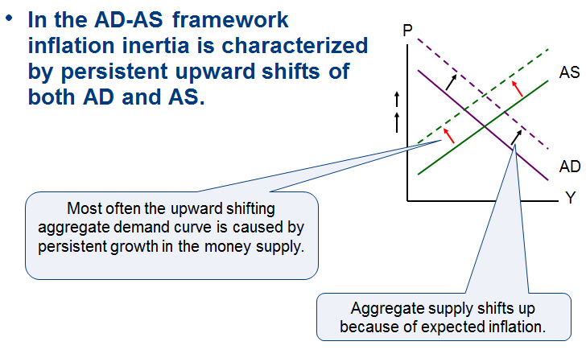
II Phillips curve
Adaptive expectation and inflation inertia

Slide 23
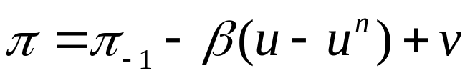
II Phillips curve
Two causes of raising and falling inflation
The second term shows that cyclical unemployment exerts upward or downward pressure on inflation. Low unemployment pulls inflation up. This is called demand-pull inflation because high AD is the cause.
The third term shows that inflation also rises and falls with supply shocks. An adverse supply shock would push production prices up. This type of inflation is called cost-push inflation.
If u = u^{n} inflation will be unchanged, therefore u^{n} is also called as non-acceleration inflation rate of unemployment (NAIRU)

Slide 24
II Phillips curve
Phillips curve in short run and long run
Inflation, π
In the short run, inflation and unemployment
are negatively related. At any point in time, a
policymaker who controls aggregate demand
can choose a combination of inflation and
unemployment on this short-run Phillips
curve.
π^{e}+v
u^{n}
Unemployment, u

Slide 25
II Phillips curve
Phillips curve in short run and long run
Π
LRPC (u=u^{n})
10%
D
E
5%
B
C
A
SRPC (Π ^{e}= 10%)
u
u^{n}
SRPC (Π ^{e}= 5%)
Unemployment, u
SRPC (Π^{e} = 0%)

Slide 26
Rational expectations and the possibility of painless disinflation
Rational expectations make the assumption that people optimally use all the available information about current government policies, to forecast the future. According to this theory, a change in monetary or fiscal policy will change expectations, and an evaluation of any policy change must incorporate this effect on expectations. If people do form their expectations rationally, then inflation may have less inertia than it first appears.
Proponents of rational expectations argue that the short-run Phillips curve does not accurately represent the options that policymakers have available. They believe that if policy makers are credibly committed to reducing inflation, rational people will understand the commitment and lower their expectations of inflation. Inflation can then come down without a rise in unemployment and fall in output

Slide 27
Hysteresis and the Challenge to the natural rate hypothesis
Our entire discussion has been based on the natural rate hypothesis. The hypothesis is summarized in the following statement: Fluctuations in aggregate demand affect output and employment only in the short run. In the long run, the economy returns to the levels of output, employment, and unemployment described by the classical model.
Recently, some economists have challenged the natural-rate hypothesis by suggesting that aggregate demand may affect output and employment even in the long run. They have pointed out a number of mechanisms through which recessions might leave permanent scars on the economy by altering the natural rate of unemployment. Hysteresis is the term used to describe the long-lasting influence of history on the natural rate.

